Slide 1
Biometric Security and Privacy
Modules 1.3(b), 1.4
By Bon Sy
Queens College/CUNY, Computer Science
Note: 1. Speech cepstrum material is based on “Speech parameterization using the Mel scale” by T. Thrasyvoulou and S. Benton
2. Performance metrics material is based on “Evaluation of Fingerprint Recognition Technologies” – BioFinger; Bundesamt fur Sicherjeit in der Informationstechnik

Slide 2
Digital media for various biometric modalities
Commonly encountered biometric modalities
  Voice
  Fingerprint
  Bio-face
  Iris
Digital media for various biometric modalities prior to signal processing: Sound/Image files
Format for sound files: WAV
Format for image files: PPM, PNG, JPEG, TIFF
For digital signal processing purpose, we want to read the information encoded under different formats as ASCII data.

Slide 3
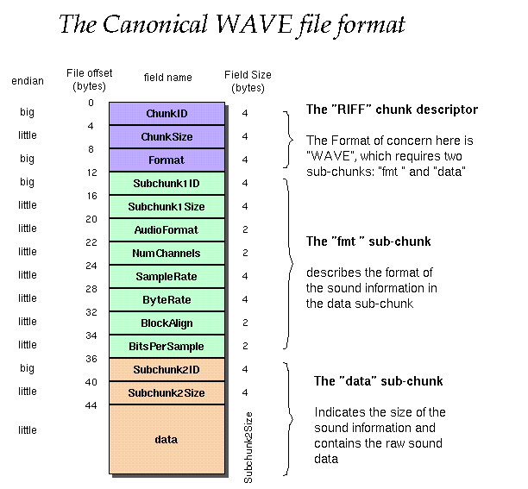
Sound file WAV format
Sound editor freeware: awave44, sox
File structure of WAV format:
http://ccrma.stanford.edu/courses/422/project

Slide 4
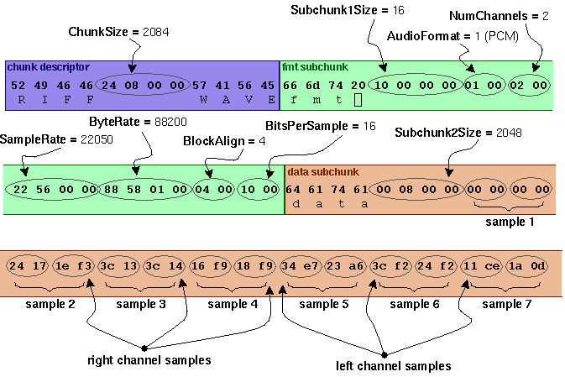
Sound file WAV format

Slide 5
Image file format
Image file converter: irfanview, imageMagick
Two categories: lossy (e.g., bitmap) and lossless (lossless JPEG)
Bitmap specification:
  http://www.fileformat.info/format/bmp/spec/e27073c25463436f8a64fa789c886d9c/view.htm
PNG (Portable Network Graphics) specification:
  E-Community case 13296

Slide 6
PPM format: http://netpbm.sourceforge.net/doc/ppm.html
PPM format – naturally ASCII
Each PPM image consists of the following:
  A "magic number" for identifying the file type. A ppm image's magic number is the two characters "P6".
  Whitespace (blanks, TABs, CRs, LFs).
  A width, formatted as ASCII characters in decimal.
  Whitespace.
  A height, again in ASCII decimal.
  Whitespace.
  The maximum color value (Maxval), again in ASCII decimal. Must be less than 65536 and more than zero.
  A single whitespace character (usually a newline).
  A raster of Height rows, in order from top to bottom. Each row consists of Width pixels, in order from left to right. Each pixel is a triplet of red, green, and blue samples, in that order. Each sample is represented in pure binary by either 1 or 2 bytes. If the Maxval is less than 256, it is 1 byte. Otherwise, it is 2 bytes. The most significant byte is first.

Slide 7
Example PPM file
P3
# feep.ppm
4 4
15
0 0 0 0 0 0 0 0 0 15 0 15
0 0 0 0 15 7 0 0 0 0 0 0
0 0 0 0 0 0 0 15 7 0 0 0
15 0 15 0 0 0 0 0 0 0 0 0

Slide 8
Digital Signal Processing
Time/Spatial-Frequency relationship
Audio signal can be thought of as a function that manifests the variation of the intensity/loudness over time; i.e., S(t).
Still image can be thought of as a signal revealing the variation of the light intensity distributed over the spatial area of the image pattern; i.e., I(x,y)

Slide 9
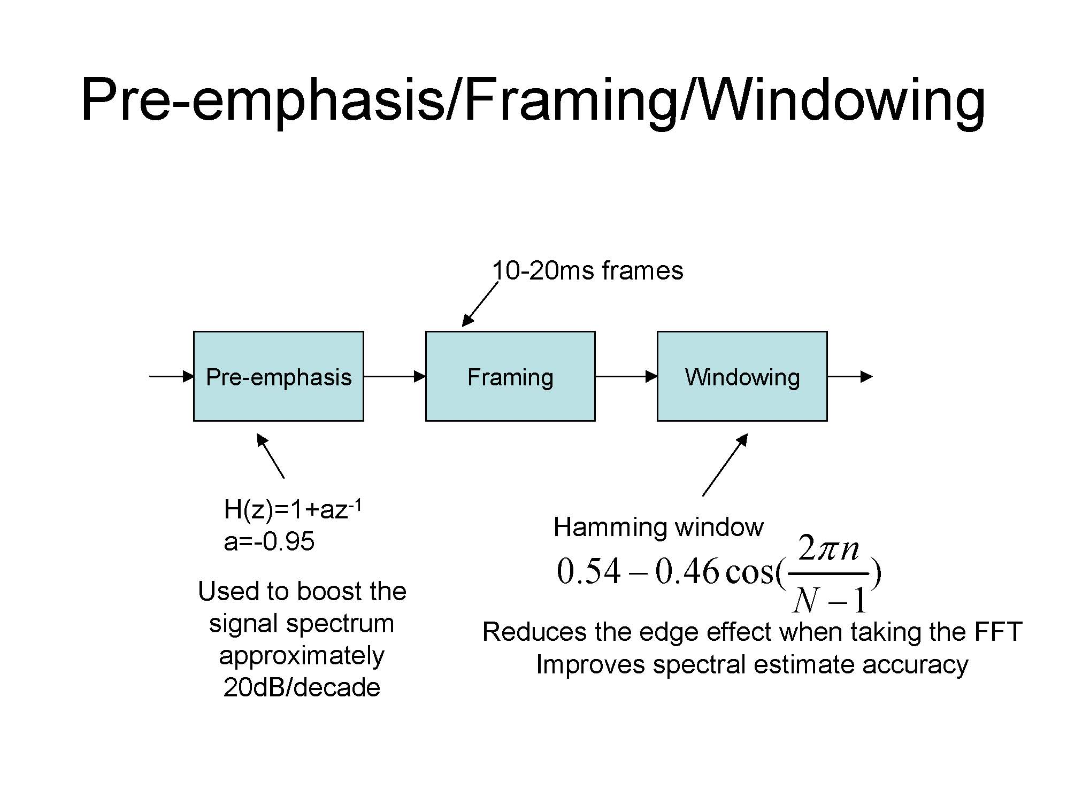

Slide 10
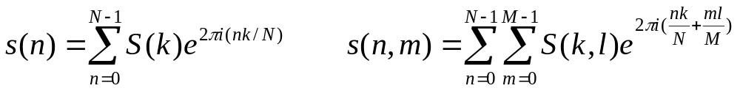
Concept of Fourier Transform
Fourier transform allows us to examine the variation of the energy spectrum of a signal over frequency domain.
Some notations used in the DSP:
  s(t): a continuous signal over continuous time.
  s(n): a continuous signal over discrete time.
  S(f): signal spectrum over continuous frequency domain.
  S(k): signal spectrum over discrete frequency domain.
Discrete fourier transform:
Inverse discrete fourier transform:

Slide 11
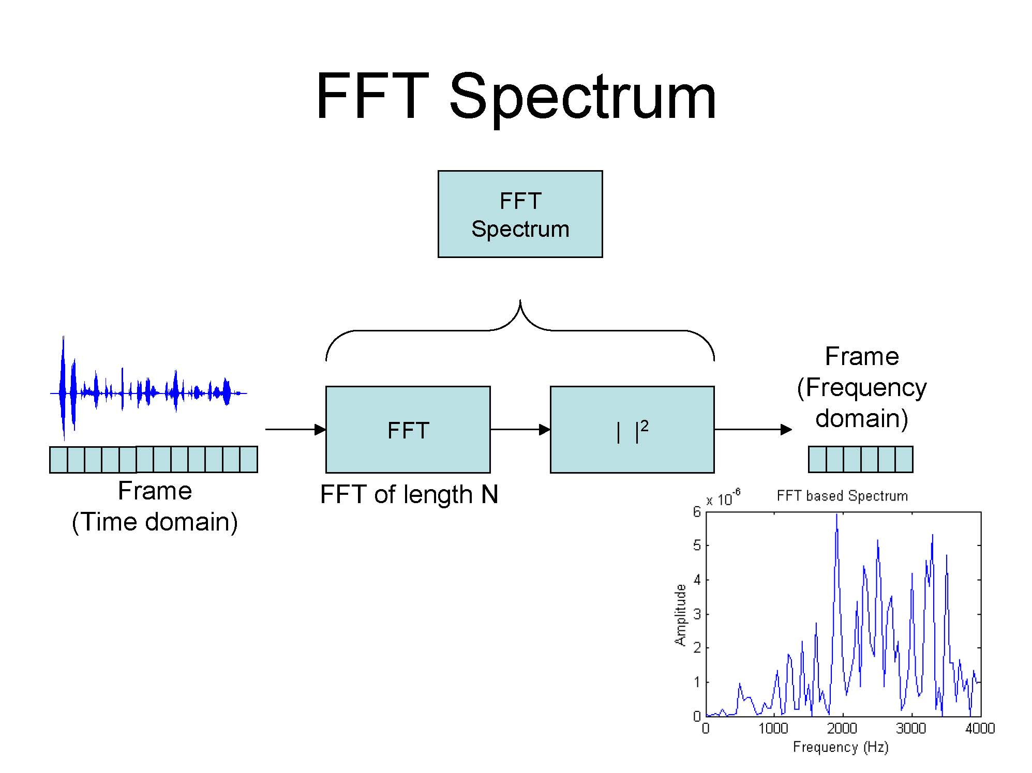

Slide 12
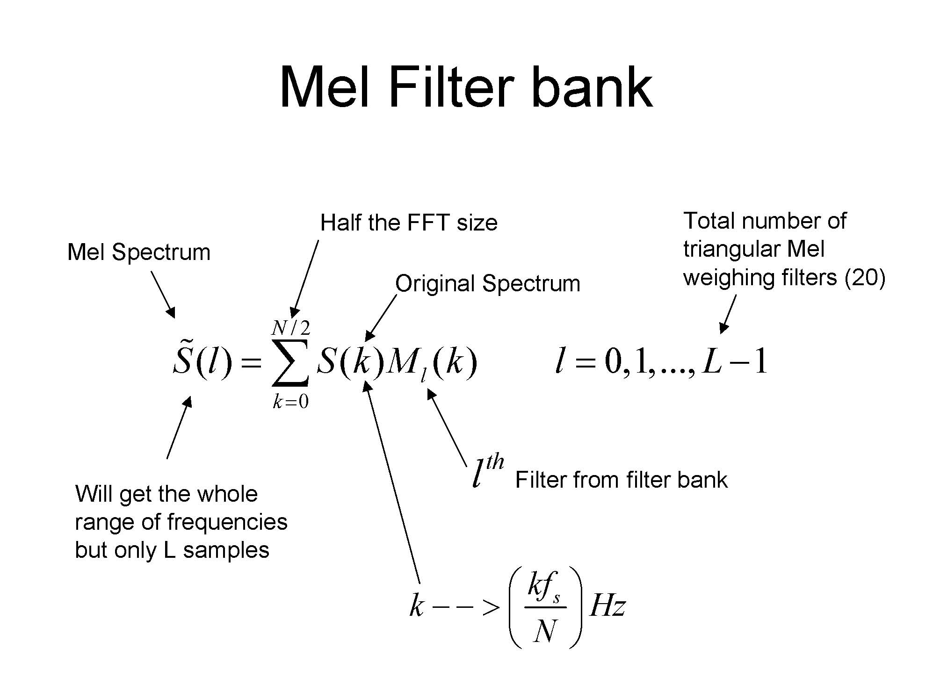

Slide 13
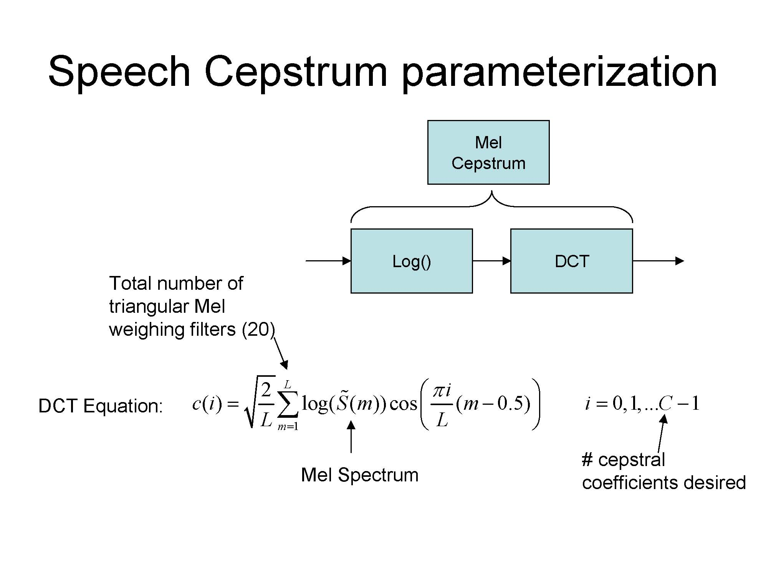

Slide 14
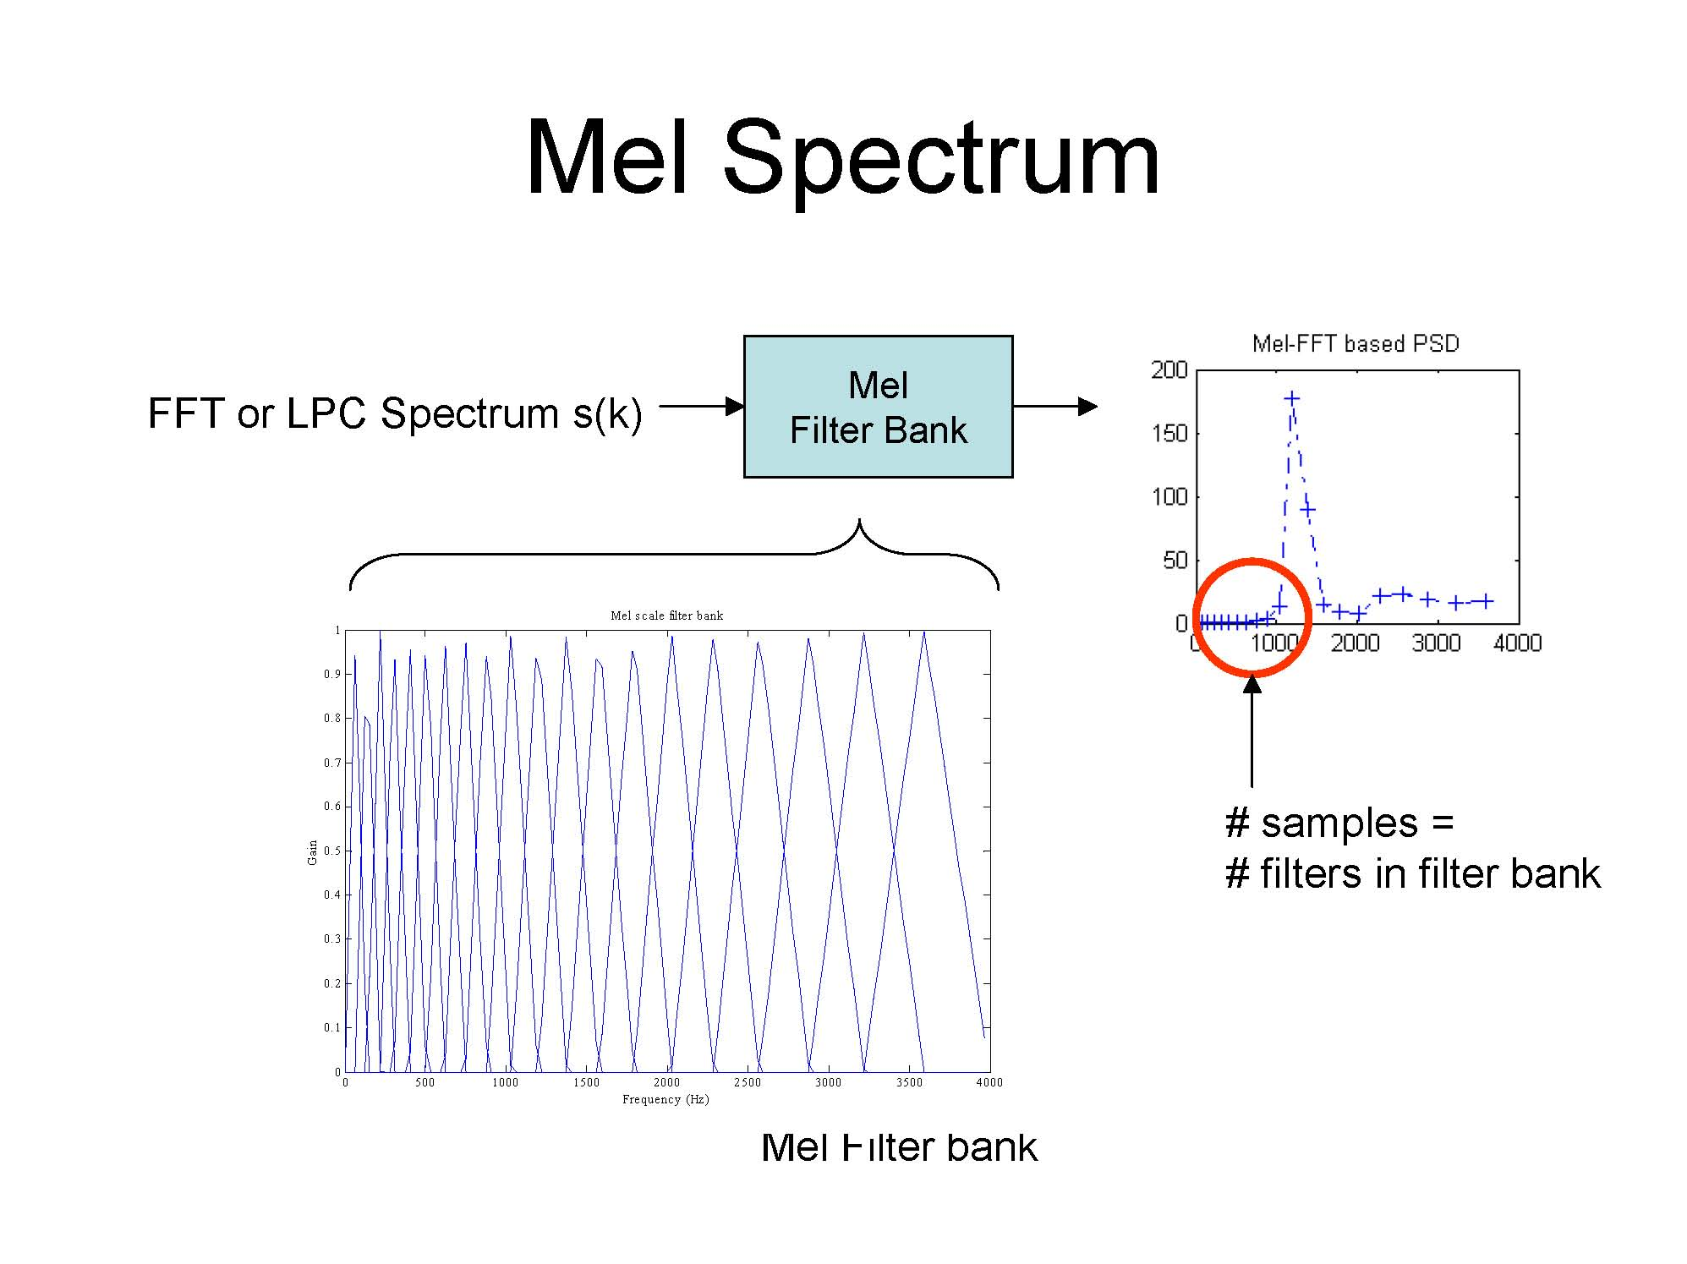

Slide 15
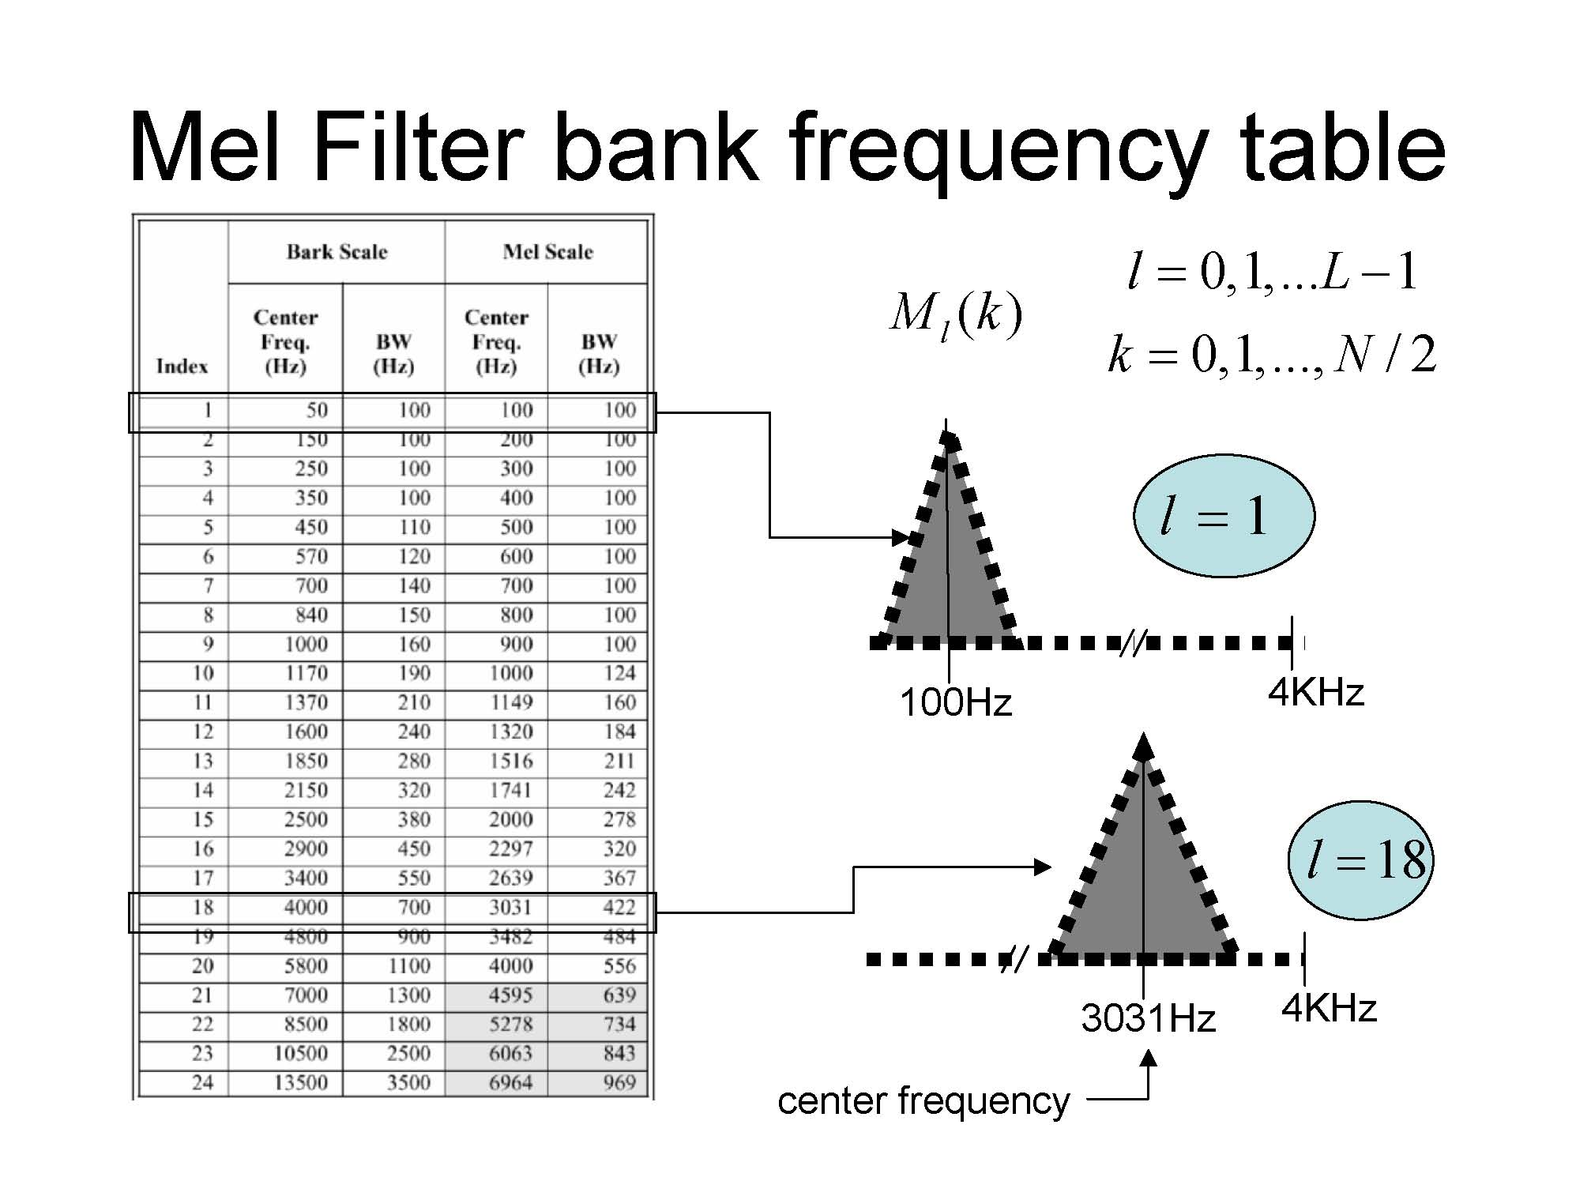

Slide 16
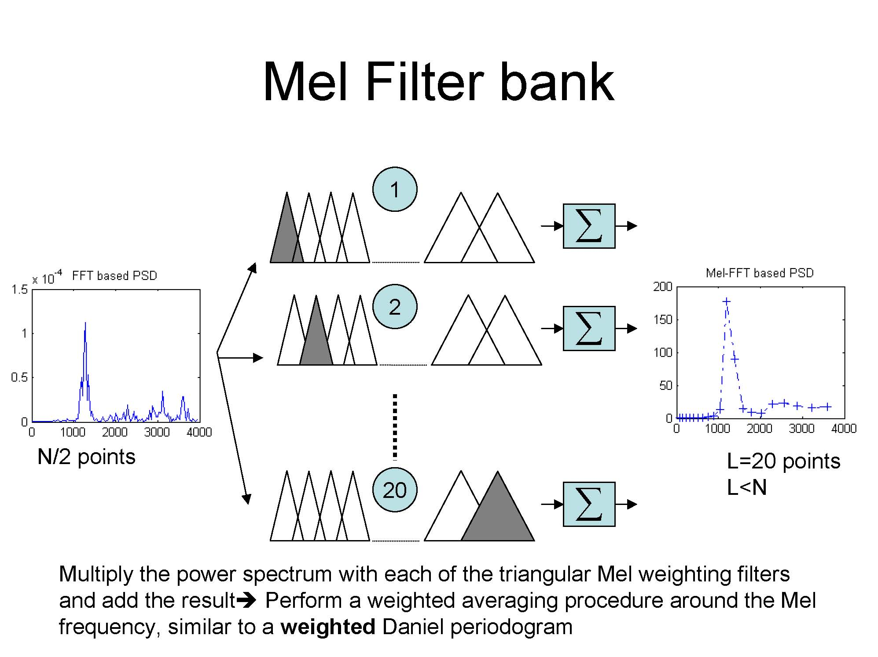

Slide 17

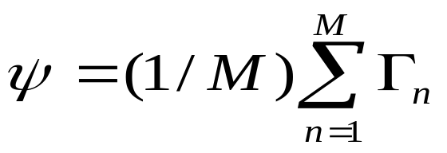
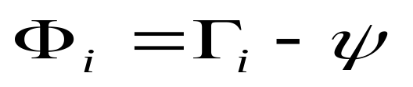
Eigen-based biometric representation
Steps
1. Let S be a set of M face images. Each image is centered, normalized to the same size, and linearized. Such set is then represented by
2. Compute the mean image Ψ:
3. Compute the difference Φ between the input image and the mean image:

Slide 18
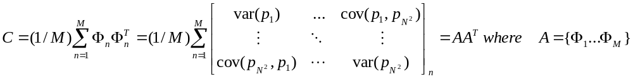
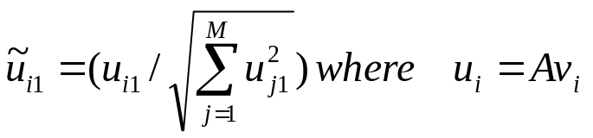
Eigen-based biometric representation
4. Obtain the covariance matrix C in the following manner
where p_{i} is the ith pixel of (image) object n.
Note that (1) A^{T}A is of dimension MxM, and AA^{T} is of dimension N²xN².
(2) for some λ_{i} and v_{i} such that (A^{T}A)v_{i}= λ_{i}v_{i}
=> AA^{T (}Av_{i})= λ_{i}(Av_{i}).
λ_{i} and v_{i} are the eigen value and eigen vector for A^{T}A respectively.
λ_{i} and Av_{i} are the eigen value and eigen vector for AA^{T} respectively.
5. Compute normalized eigenvector:

Slide 19

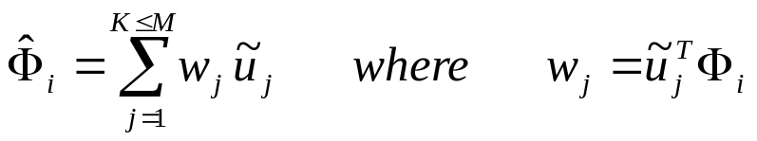


Eigen-based biometric representation
6. Representing a face onto the basis of the normalized eigenvector:
  is project to each eigenvector dimension via the above equation.
  is a scalar that acts as a weight w_{j} to the eigenvector in the linear combination expression for representing the original image.
7. Now we can think the set of weight as the “feature vector” for the face; i.e., is represented as

Slide 20
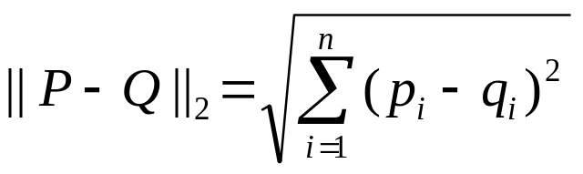
Decision function and threshold
1. Euclidean distance between two vectors P =(p₁ … p_{n})^{T} and Q=(q₁ … p_{n})^{T}:
2. Hamming distance
  Let S(n) and G(n) be two sequences of objects for n = 1..M.
  f(a,b) = 1 if a=b, or 0 otherwise.
  Hamming distance HamDis(S,G)=∑_{i=1..M} f(S(i),G(i))
3. Kullback Leibler (KL) distance from N0_{N}(μ0,Σ0) to N1_{N}(μ1,Σ1) :
  tr(A) = ∑_{i} a_{ii}
4. Symmetric distance function based on Kullback Leibler:
  (1/2)[D_{KL}(N0||N1) + D_{KL}(N1||N0)]

Slide 21




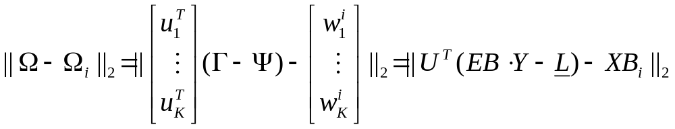
Eigen-object distance function and threshold
Given an unknown (face) object
Compute
Derive the projection of onto the eigen-dimension:
Decision function between two eigen-dimension (face) objects :

Slide 22
General form of Eigen-face detection
Denote ||U^{T}(EB∙Y - Ḻ) - XB_{i}||₂ as 2-norm Euclidean distance measurement, and δ_{k} as a threshold related to object class i.
  Bio-face verification for object i: ||U^{T}(EB∙Y-Ḻ)-XB_{i}||₂-δ_{i} < 0?
  Bio-face identification: ArgMin_{i} [||U^{T}(EB∙Y-Ḻ)-XB_{i}||₂]

Slide 23
Change point detection
Change point detection for (the Impact of) aging effect:
Intentionally left blank

Slide 24
Performance metrics
False match/positive: Two instances of different classes are categorized as being identical.
False non-match/negative: Two instances of same class are categorized as being different.
Confusion matrix: Tabulation of frequency information on object i categorized as object j for all I, j.
  Confusion matrix applies to only biometric identification, not verification.
False Acceptance Rate (FAR)= # of false match/population
False Rejection Rate (FRR)= # of false non-match/population
FAR and FRR are measurements that marginalized away the choice of threshold.

Slide 25
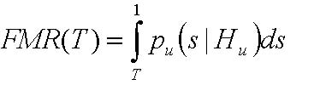
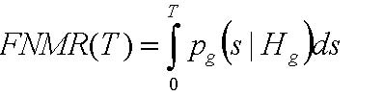
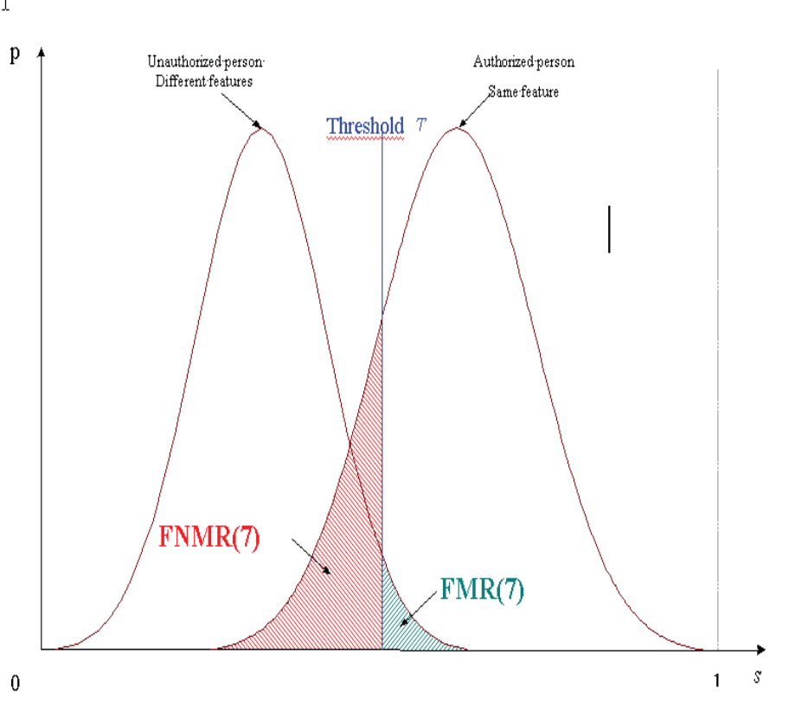
Performance metrics
False Match Rate at threshold T:
False Non-Match Rate at threshold T:
  Decision threshold T,
  Statement "different" H_{u} (enrolled fingerprint and template come from different fingers),
  Statement "identical" H_{g} (enrolled fingerprint and template come from the same finger),
  Probability density p which fulfils the hypothesis in brackets, and
  Matching Score s.

Slide 26
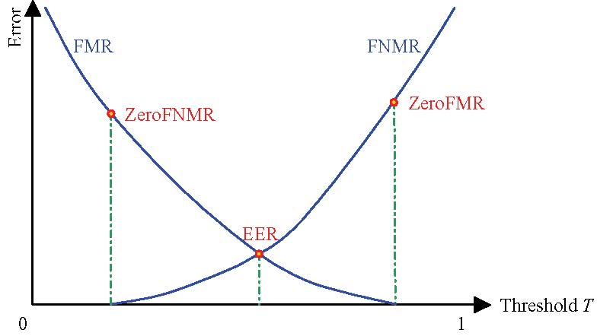
Relationship among FMR, FNMR, EER, T

Slide 27
Error factors for objective comparison
Failure To Acquire Rate (FTA)
  Hardware dependency
Failure To Enroll Rate (FTE)
  Quality assurance dependency
Failure To Match Rate (FTM)
  Threshold selection dependency
FAR(T)= (1-FTA)x(1-FTE)xFMR(T)
FRR(T)=FTA+(1-FTA)xFTE+(1-FTA)x(1-FTE)xFNMR(T)

Slide 28
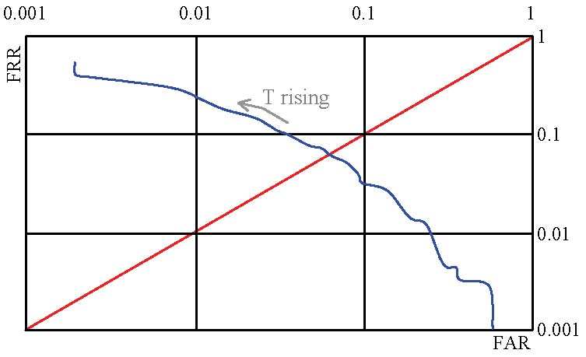
Performance metrics
ROC (Receiver Operating Characteristics Curve)

Slide 29
Performance metrics
Let A be an observed attribute/feature instantiation and C be a biometric category/class.
  Support measure: Support(A) = Pr(A)
  Support(A->C) = Support(A and C)
  Confidence(A->C) = Support(A and C)/Support(A)
  Lift(A->C) = Confidence(A->C)/Support(C)
  Leverage(A->C) = Support(A->C) – Support(A)*Support(C)

